Slide 1
May 16 - May 20
Main focus:
Applying linguistics features to the regression model to predict the results
Reading papers about Long Transformer and adding Bert/Transformer to the regression model

Slide 2
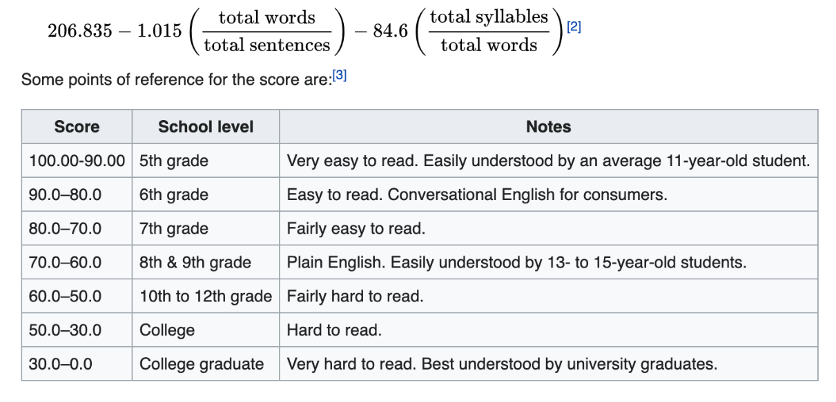
Flesch Reading Ease
The Flesch Reading Ease (FRES) score says how easy something is to read.

Slide 3
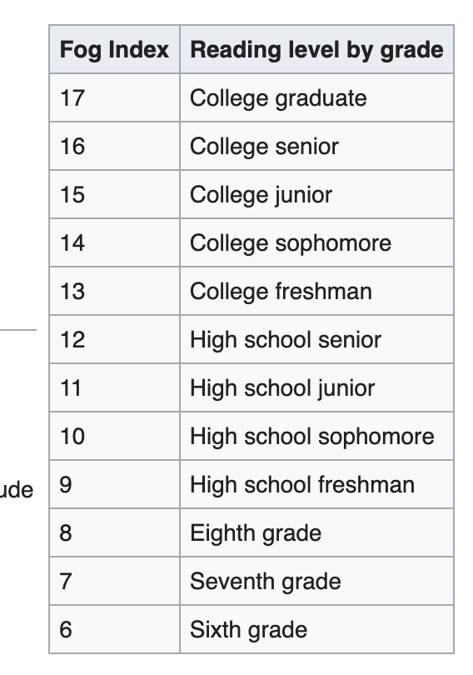
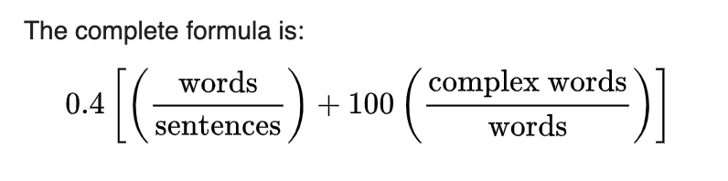
Gunning fog index
Count the "complex" words consisting of three or
more syllables.

Slide 4
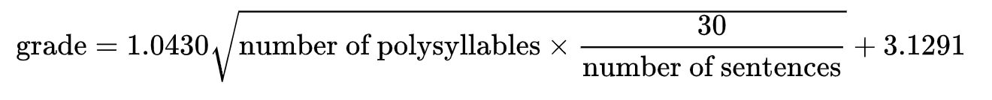
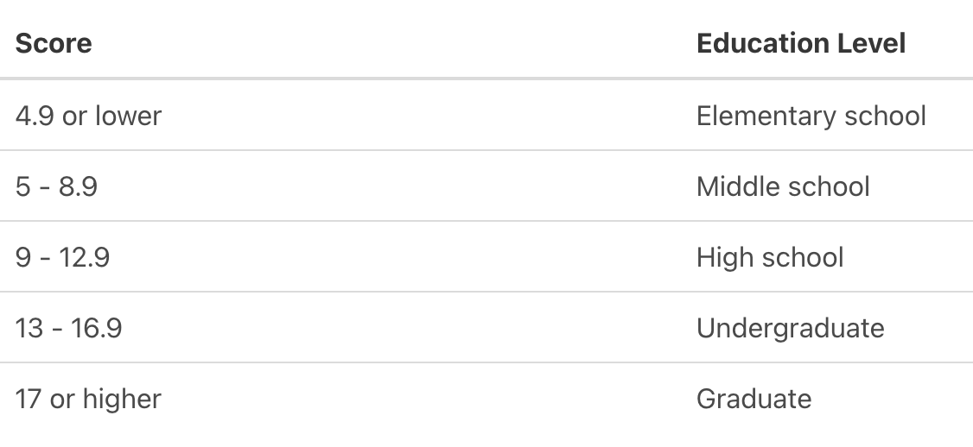
SMOG readability
polysyllables (words of 3 or more syllables)

Slide 5
Transcript
Readability
- flesch_reading_ease
- gunning_fog
- smog_index
- dale_chall_readability_score
POS tag statistics from NLTK
Verb, Noun, Named Noun, Adverb, etc.
Named Entity Recognition
Potential ideas: Text coherence, Informativity, …
Question: any other indicators that we could leverage?

Slide 6
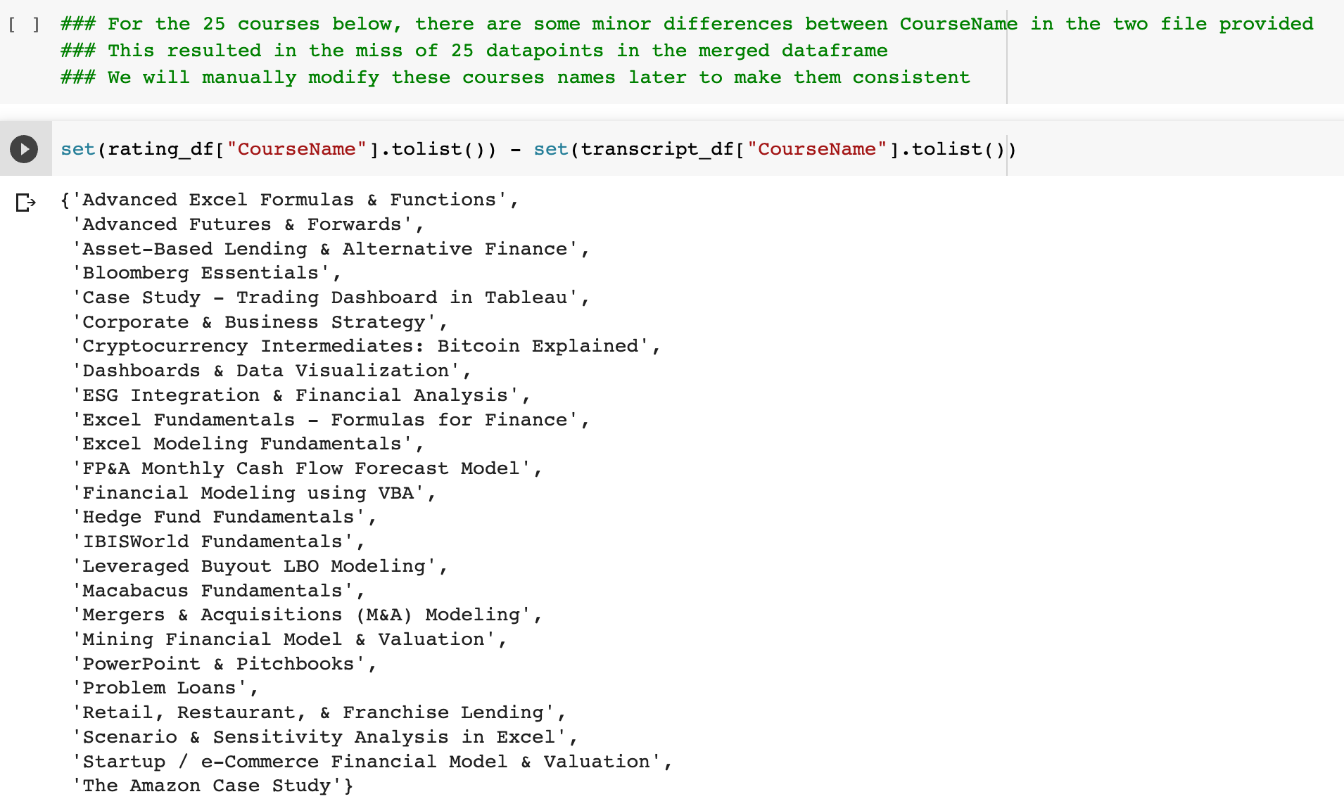
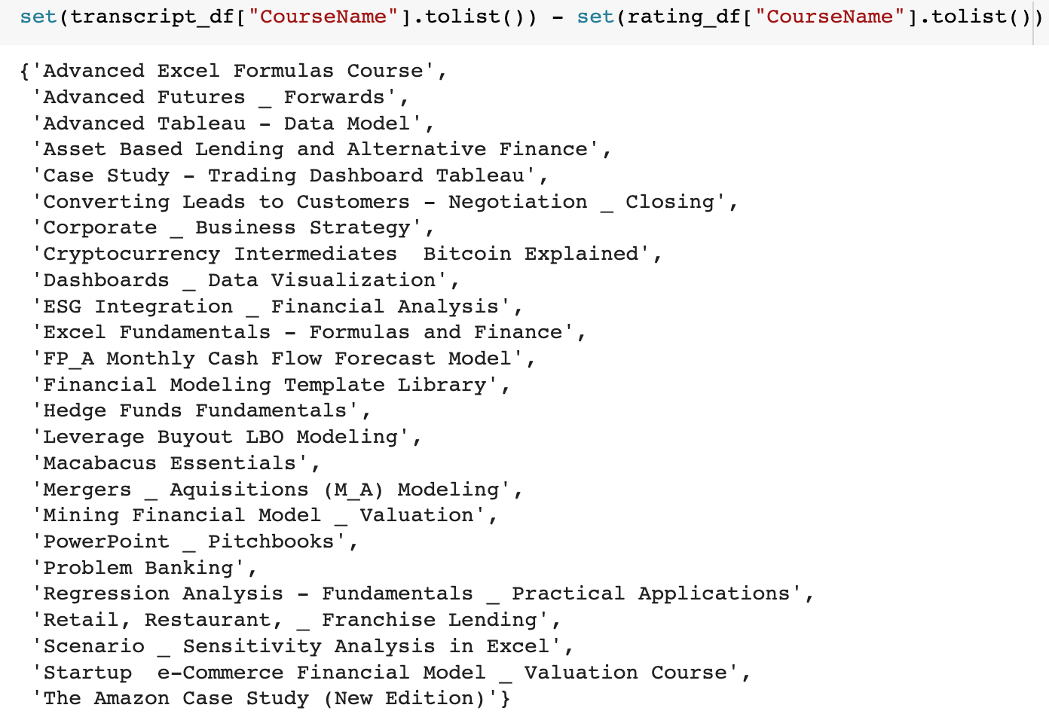
Question：Which CourseNames should be kept?

Slide 7
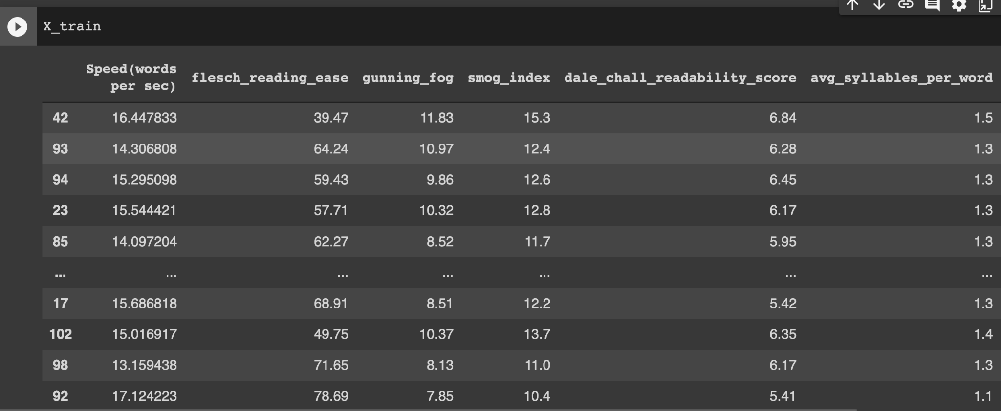
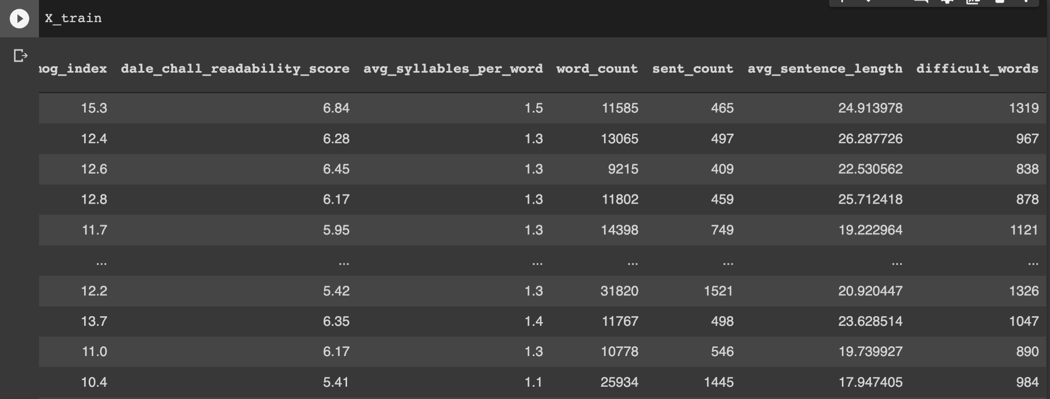
Dataset

Slide 8
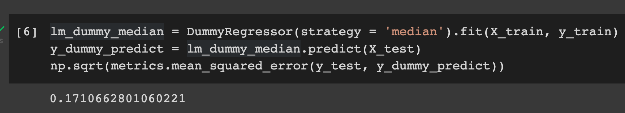
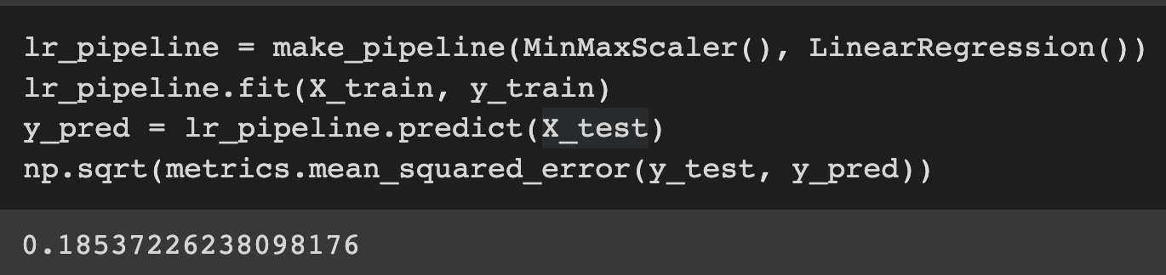
Regression models
Dummy Regressor as the baseline model:
Normal linear regression shows overfitting:

Slide 9
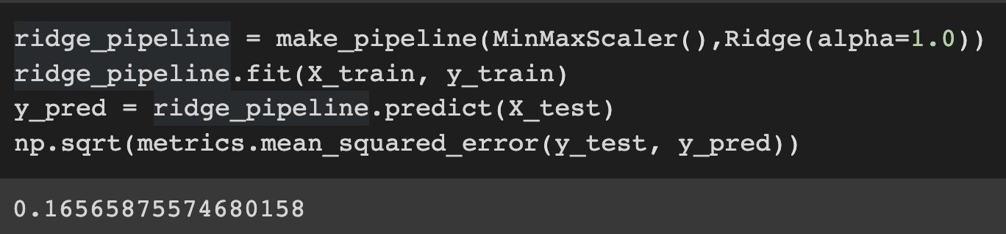
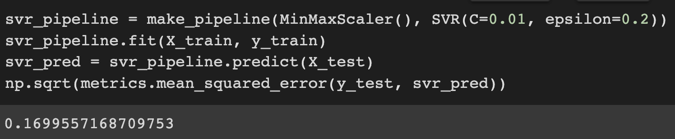
Regression models
Ridge regression with alpha = 1.0
MinMaxScalar shows the best results among all scalars.

Slide 10
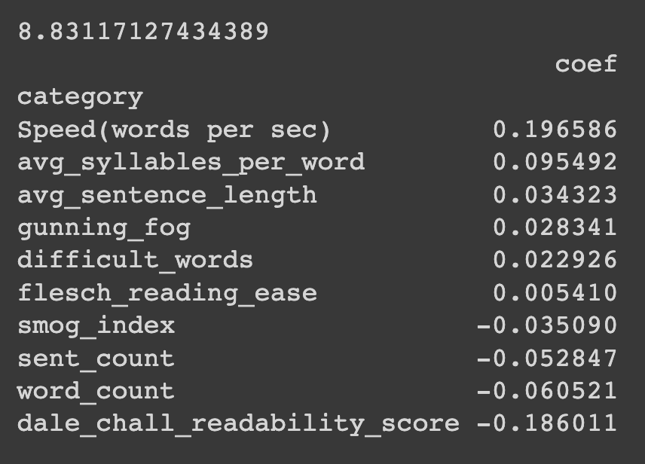
Regression models
Ridge regression coefficients:

Slide 11
Models - Longformer (Long-Document Transformer)/BERT
Why do we use Longformer/BERT:
Transformer-based models are unable to process long sequences due to their self-attention operation
Longformer addresses this limitation by using an attention mechanism that scales linearly with sequence length, making it easy to process documents of thousands of tokens or longer
Results(Transformer):
(trained for 10 epochs)
Limitations:
Resource hungry - CUDA out of memory error
strategies:
Reduce the batch size from 32 to 4 to solve the memory error
Take each chapter as input instead of the whole course to solve the limitation of 512 input tokens
Training loss | Validation loss
0.134 | 0.035

Slide 12
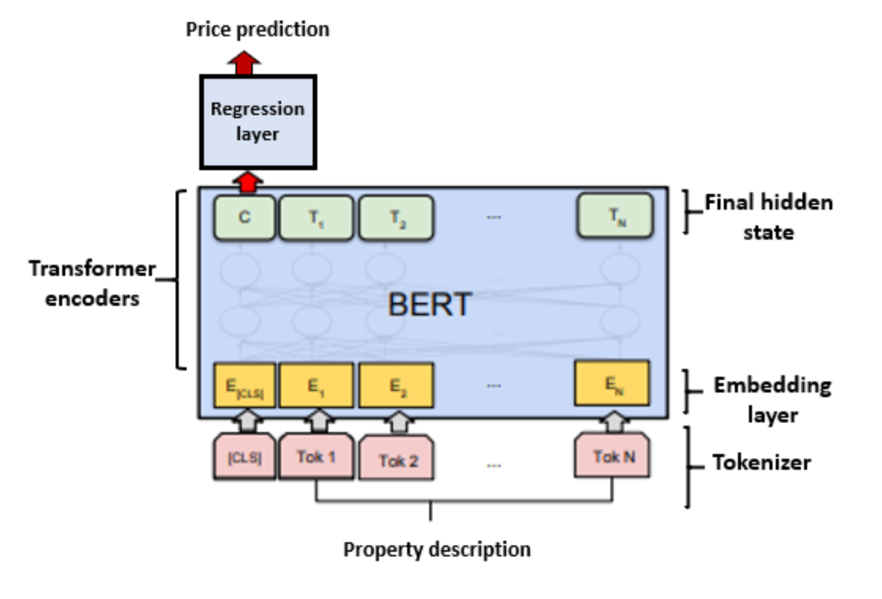
What we can do next:
We can combine numerical and textual features with two approaches:
Use text embedding techniques to extract meaningful quantitative features from the transcripts. The embedding features can then be appended to the other numerical features and used with the supervised regression models mentioned above.
Fine-tune a BERT based network that includes the numerical features. These features could for example be appended to the final hidden states before being sent through a regression layer.
With more information at hand, we would expect combining numerical and textual features to achieve better performances.
numerical features
transcripts

